Slide 1
CS2102 Database Systems Slides adapted from Prof. Chan Chee Yong
Lecture 05
SQL #2

Slide 2
PREVIOUS LECTURE
Relationship constraints
Types
Many-to-many Each instance of E participates in 0 or more instance of R
Key Each instance of E participates in at most 1 instance of R
Total Each instance of E participates in at least 1 instance of R
Key & total Each instance of E participates in exactly one instance of R
Weak entity E is a weak entity set with identifying owner E’ and identifying relationship set R
E
R
E
R
E
R
E
R
E
R
E’

Slide 3
PREVIOUS LECTURE
ER diagram to SQL
Entity sets
CREATE TABLE E (
pk1 type,
pk2 type,
attr type,
PRIMARY KEY (pk1, pk2)
);
Many-to-many
CREATE TABLE R (
pk1 type REFERENCES E1,
pk2 type REFERENCES E2,
attr type,
PRIMARY KEY (pk1, pk2)
);
attr
pk1
pk2
E
attr1
attr
attr3
pk1
pk2
E1
R
E2

Slide 4
PREVIOUS LECTURE
ER diagram to SQL
Key constraints approach #1
CREATE TABLE R (
pk1 type REFERENCES E1,
pk2 type REFERENCES E2,
attr type,
PRIMARY KEY (pk1)
);
Key constraints approach #2
CREATE TABLE R (
pk1 type PRIMARY KEY,
pk2 type REFERENCES E2,
attr type,
attr1 type
);
attr1
attr
attr3
pk1
pk2
E1
R
E2
attr1
attr
attr3
pk1
pk2
E1
R
E2

Slide 5
PREVIOUS LECTURE
ER diagram to SQL
Key & total constraints
CREATE TABLE R (
pk1 type PRIMARY KEY,
pk2 type NOT NULL,
attr type,
attr1 type,
FOREIGN KEY (pk2) REFERENCES E2
);
Weak entity sets
CREATE TABLE R (
pk1 type,
pk2 type REFERENCES E2
ON DELETE cascade,
attr type,
attr1 type,
PRIMARY KEY (pk1, pk2)
);
attr1
attr
attr3
pk1
pk2
E1
R
E2
attr1
attr
attr3
pk1
pk2
E1
R
E2

Slide 6
PREVIOUS LECTURE
Additional ER concepts
ISA hierarchies approach #1
CREATE TABLE E (
pk type PRIMARY KEY
);
CREATE TABLE E1 (
pk type
PRIMARY KEY
REFERENCES E ON DELETE cascade
);
CREATE TABLE E2 (
pk type
PRIMARY KEY
REFERENCES E ON DELETE cascade
);
pk
E
pk
pk
E1
E2

Slide 7
PREVIOUS LECTURE
Additional ER concepts
ISA hierarchies approach #2
CREATE TABLE E1 (
pk type
PRIMARY KEY
);
CREATE TABLE E2 (
pk type
PRIMARY KEY
);
pk
E
pk
pk
E1
E2

Slide 8
PREVIOUS LECTURE
Additional ER concepts
Aggregation
CREATE TABLE R2 (
pk type REFERENCES E,
pk1 type,
pk2 type,
attrB type,
PRIMARY KEY (pk, pk1, pk2),
FOREIGN KEY (pk1, pk2)
REFERENCES R1 (pk1, pk2)
);
E
pk
attr
attrB
R2
E1
R1
E2
pk1
pk2
attr1
attrA
attr3

Slide 9
Overview
More conditions
Pattern matching
Conditional expressions: case analysis
Conditional expressions: null analysis
Multi-relation queries
Set operations
Cross-product
Join: inner join, left outer join, right outer join, full outer join, natural join
Views

Slide 10
More conditions
More conditions
Pattern matching
Conditional expressions: case analysis
Conditional expressions: null analysis
Multi-relation queries
Set operations
Cross-product
Join: inner join, left outer join, right outer join, full outer join, natural join
Views

Slide 11
More conditions
Basic
Syntax
SELECT [ DISTINCT ] select_list
FROM from_list
WHERE condition
What can the condition be?
Pattern matching LIKE
Conditional expression
Case analysis CASE ... END
Null analysis NULLIF, COALESCE

Slide 12
More conditions
Pattern matching
Syntax
attr LIKE pattern
Rules for pattern
Underscore (_) match any single character
Percent (%) match sequence of 0 or more characters
Example:
‘abc’ LIKE ‘abc’
‘abc’ LIKE ‘a%’
‘abc’ LIKE ‘_b_’
‘abc’ LIKE ‘c’

Slide 13
More conditions
Pattern matching
Syntax
attr LIKE pattern
Rules for pattern
Underscore (_) match any single character
Percent (%) match sequence of 0 or more characters
Example:
‘abc’ LIKE ‘abc’ True
‘abc’ LIKE ‘a%’ True
‘abc’ LIKE ‘_b_’ True
‘abc’ LIKE ‘c’ False

Slide 14
More conditions
Pattern matching
Question:
Find all customer names ending with “e” that consists of at least four characters
Query:
SELECT cname FROM Customers
WHERE cname LIKE ‘_ _ _ % e’;
Customers
cname | area
Homer | West
Lisa | South
Maggie | East
Moe | Central
Ralph | Central
Willie | North
Output
cname
Maggie
Willie

Slide 15
More conditions
Pattern matching
Question:
Find all customer names starting with “M” and ending with “e”
Query:
SELECT cname FROM Customers
WHERE cname LIKE ;
Customers
cname | area
Homer | West
Lisa | South
Maggie | East
Moe | Central
Ralph | Central
Willie | North
Output
cname
Maggie
Moe

Slide 16
More conditions
Pattern matching
Question:
Find all customer names starting with “M” and ending with “e”
Query:
SELECT cname FROM Customers
WHERE cname LIKE ‘M % e’ ;
Customers
cname | area
Homer | West
Lisa | South
Maggie | East
Moe | Central
Ralph | Central
Willie | North
Output
cname
Maggie
Moe

Slide 17
More conditions
Conditional expressions
Case analysis
Syntax
CASE [expression]
WHEN condition THEN result
[ WHEN ... ]
[ ELSE result ]
END

Slide 18
More conditions
Conditional expressions
Case analysis
If the student get marks >= 85, the student get grade ‘A’
Else if the student get marks >= 75 on marks, the student get grade ‘B’
Else if the student get marks >= 65 on marks, the student get grade ‘C’
Otherwise, the student get grade ‘D’
Query
SELECT name, CASE
WHEN THEN
WHEN THEN
WHEN THEN
ELSE
END AS grade
FROM Scores;
Scores
name | marks
Alice | 92
Bob | 78
Carol | 65
Dave | 47
Output
name | grades
Alice | A
Bob | B
Carol | C
Dave | D

Slide 19
More conditions
Conditional expressions
Case analysis
If the student get marks >= 85, the student get grade ‘A’
Else if the student get marks >= 75 on marks, the student get grade ‘B’
Else if the student get marks >= 65 on marks, the student get grade ‘C’
Otherwise, the student get grade ‘D’
Query
SELECT name, CASE
WHEN marks >= 85 THEN ‘A’ -- #1
WHEN marks >= 75 THEN ‘B’ -- #2
WHEN marks >= 65 THEN ‘C’ -- #3
ELSE ‘D’ -- #4
END AS grade
FROM Scores;
Scores
name | marks
Alice | 92
Bob | 78
Carol | 65
Dave | 47
Output
name | grades
Alice | A
Bob | B
Carol | C
Dave | D

Slide 20
More conditions
Conditional expressions
Null analysis
Scenario student may attempt a quiz
On passing the value is ‘pass’; the status is marked as ‘pass’
On failing the value is ‘fail’, the status is marked as ‘fail’
On absent the value is ‘absent’, the status is marked as null
SELECT name, CASE
WHEN ( ) ( )
THEN result
END AS status
FROM Quizzes;
Quizzes
name | result
Alice | absent
Bob | fail
Carol | pass
Dave | absent
Eve | pass
Output
name | status
Alice | null
Bob | fail
Carol | pass
Dave | null
Eve | pass

Slide 21
More conditions
Conditional expressions
Null analysis
Scenario student may attempt a quiz
On passing the value is ‘pass’; the status is marked as ‘pass’
On failing the value is ‘fail’, the status is marked as ‘fail’
On absent the value is ‘absent’, the status is marked as null
SELECT name, CASE
WHEN (result = ‘pass’) OR (result = ‘fail’)
THEN result
END AS status
FROM Quizzes;
Quizzes
name | result
Alice | absent
Bob | fail
Carol | pass
Dave | absent
Eve | pass
Output
name | status
Alice | null
Bob | fail
Carol | pass
Dave | null
Eve | pass

Slide 22
More conditions
Conditional expressions
Null analysis
Scenario student may attempt a quiz
On passing the value is ‘pass’; the status is marked as ‘pass’
On failing the value is ‘fail’, the status is marked as ‘fail’
On absent the value is ‘absent’, the status is marked as null
SELECT name, NULLIF (result, ‘absent’) AS status
FROM Quizzes;
NULLIF (value₁, value₂)
Returns null
if value₁ equals to value₂
otherwise, value₁
Quizzes
name | result
Alice | absent
Bob | fail
Carol | pass
Dave | absent
Eve | pass
Output
name | status
Alice | null
Bob | fail
Carol | pass
Dave | null
Eve | pass

Slide 23
More conditions
Conditional expressions
Null analysis
Scenario student may attempt quiz up to 3 times
On passing the value is ‘pass’; cannot attempt further quizzes
On failing the value is ‘fail’, may attempt further quizzes
On absent the value is null, may attempt further quizzes
SELECT name, CASE
WHEN ( ) OR ( ) OR
( )
THEN ‘pass’
ELSE ‘fail’
END AS result
FROM Quiz3;
Quiz3
name | first | second | third
Alice | pass | null | null
Bob | fail | pass | null
Carol | fail | fail | pass
Dave | fail | null | fail
Eve | fail | fail | null
Output
name | result
Alice | pass
Bob | pass
Carol | pass
Dave | fail
Eve | fail

Slide 24
More conditions
Conditional expressions
Null analysis
Scenario student may attempt quiz up to 3 times
On passing the value is ‘pass’; cannot attempt further quizzes
On failing the value is ‘fail’, may attempt further quizzes
On absent the value is null, may attempt further quizzes
SELECT name, CASE
WHEN (first = ‘pass’) OR (second = ‘pass’) OR
(third = ‘pass’)
THEN ‘pass’
ELSE ‘fail’
END AS result
FROM Quiz3;
Quiz3
name | first | second | third
Alice | pass | null | null
Bob | fail | pass | null
Carol | fail | fail | pass
Dave | fail | null | fail
Eve | fail | fail | null
Output
name | result
Alice | pass
Bob | pass
Carol | pass
Dave | fail
Eve | fail

Slide 25
More conditions
Conditional expressions
Null analysis
Scenario student may attempt quiz up to 3 times
On passing the value is ‘pass’; cannot attempt further quizzes
On failing the value is ‘fail’, may attempt further quizzes
On absent the value is null, may attempt further quizzes
SELECT name,
COALESCE (third, second, first) AS result
FROM Quiz3; -- does order matter?
coalesce returns the first non-null value in its argument
null is returned if all arguments are null
Quiz
name | first | second | third
Alice | pass | null | null
Bob | fail | pass | null
Carol | fail | fail | pass
Dave | fail | null | fail
Eve | fail | fail | null
Output
name | result
Alice | pass
Bob | pass
Carol | pass
Dave | fail
Eve | fail

Slide 26
Multi-relation queries
More conditions
Pattern matching
Conditional expressions: case analysis
Conditional expressions: null analysis
Multi-relation queries
Set operations
Cross-product
Join: inner join, left outer join, right outer join, full outer join, natural join
Views

Slide 27
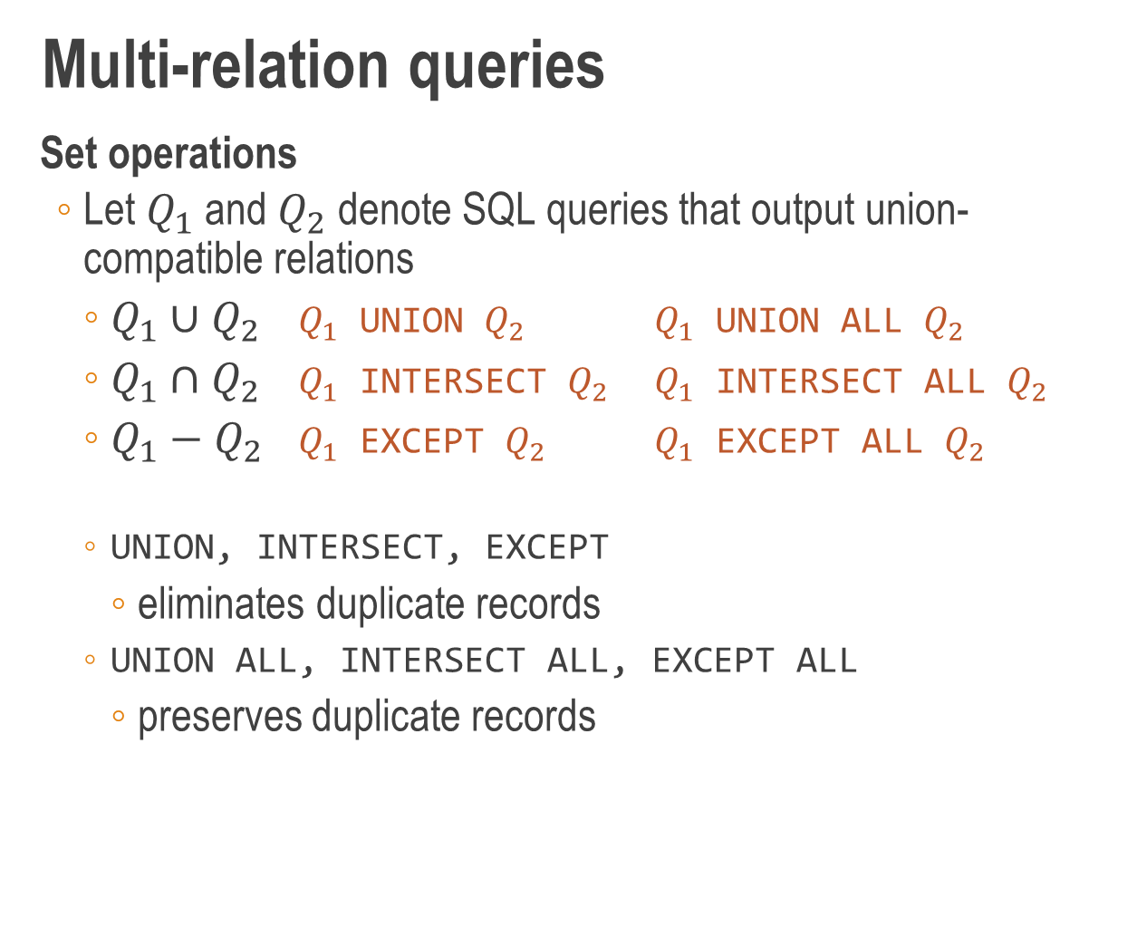
Multi-relation queries
Set operations
Let $Q_{1}$ and $Q_{2}$ denote SQL queries that output union-compatible relations
$Q_{1}∪Q_{2}$ $Q_{1}$ UNION $Q_{2}$ $Q_{1}$ UNION ALL $Q_{2}$
$Q_{1}∩Q_{2}$ $Q_{1}$ INTERSECT $Q_{2}$ $Q_{1}$ INTERSECT ALL $Q_{2}$
$Q_{1}−Q_{2}$ $Q_{1}$ EXCEPT $Q_{2}$ $Q_{1}$ EXCEPT ALL $Q_{2}$
UNION, INTERSECT, EXCEPT
eliminates duplicate records
UNION ALL, INTERSECT ALL, EXCEPT ALL
preserves duplicate records

Slide 28
Multi-relation queries
Set operations
Union: Find all customer/restaurant names
SELECT cname FROM Customers
UNION
SELECT rname FROM Restaurants;
Intersect: Find all pizzas that contain both cheese and chilli
SELECT pizza FROM Contains WHERE ingredient = ‘cheese’
INTERSECT
SELECT pizza FROM Contains WHERE ingredient = ‘chilli’;
Set difference: Find all pizzas that contain cheese but not chilli
SELECT pizza FROM Contains WHERE ingredient = ‘cheese’
EXCEPT
SELECT pizza FROM Contains WHERE ingredient = ‘chilli’;

Slide 29
Multi-relation queries
Set operations
ALL vs no ALL
Q1: SELECT B FROM R EXCEPT SELECT D FROM S;
Q2: SELECT B FROM R EXCEPT ALL SELECT D FROM S;
R
A | B
10 | 1
20 | 1
30 | 1
40 | 2
50 | 3
60 | 4
70 | 4
S
C | D
10 | 1
20 | 5
30 | 2
40 | 2
50 | 3
Q1
B
4
Q2
B
1
1
4
4

Slide 30
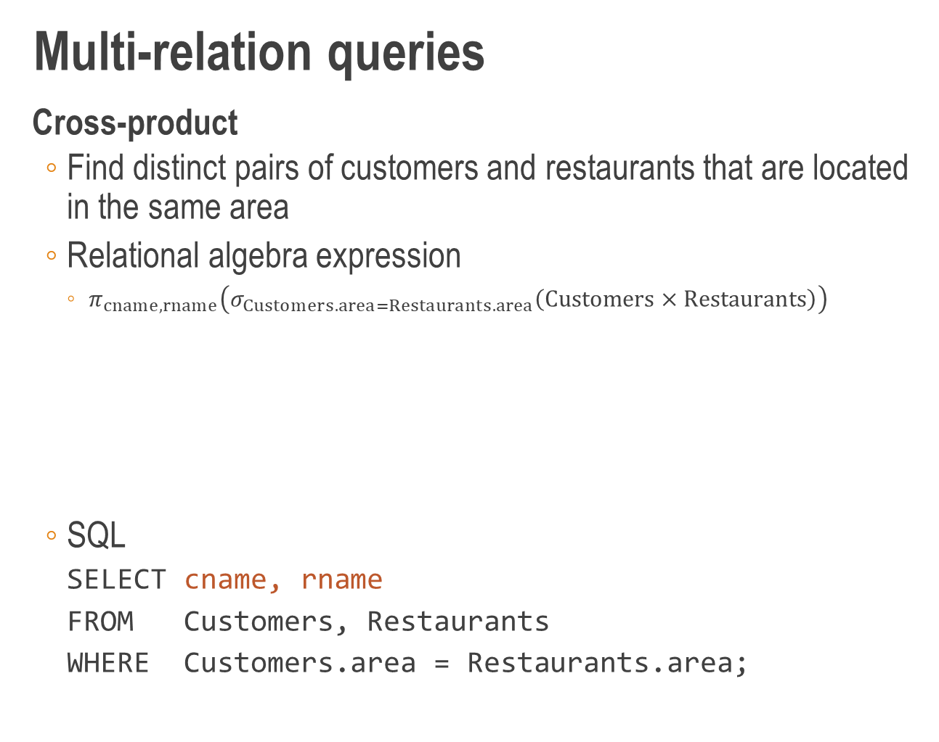
Multi-relation queries
Cross-product
Find distinct pairs of customers and restaurants that are located in the same area
Relational algebra expression
$π_{cname,rname}\left(σ_{Customers.area=Restaurants.area}\left(Customers×Restaurants\right)\right)$
SQL
SELECT cname, rname
FROM Customers, Restaurants
WHERE Customers.area = Restaurants.area;
projection
selection
cross product
SELECT
WHERE
FROM

Slide 31
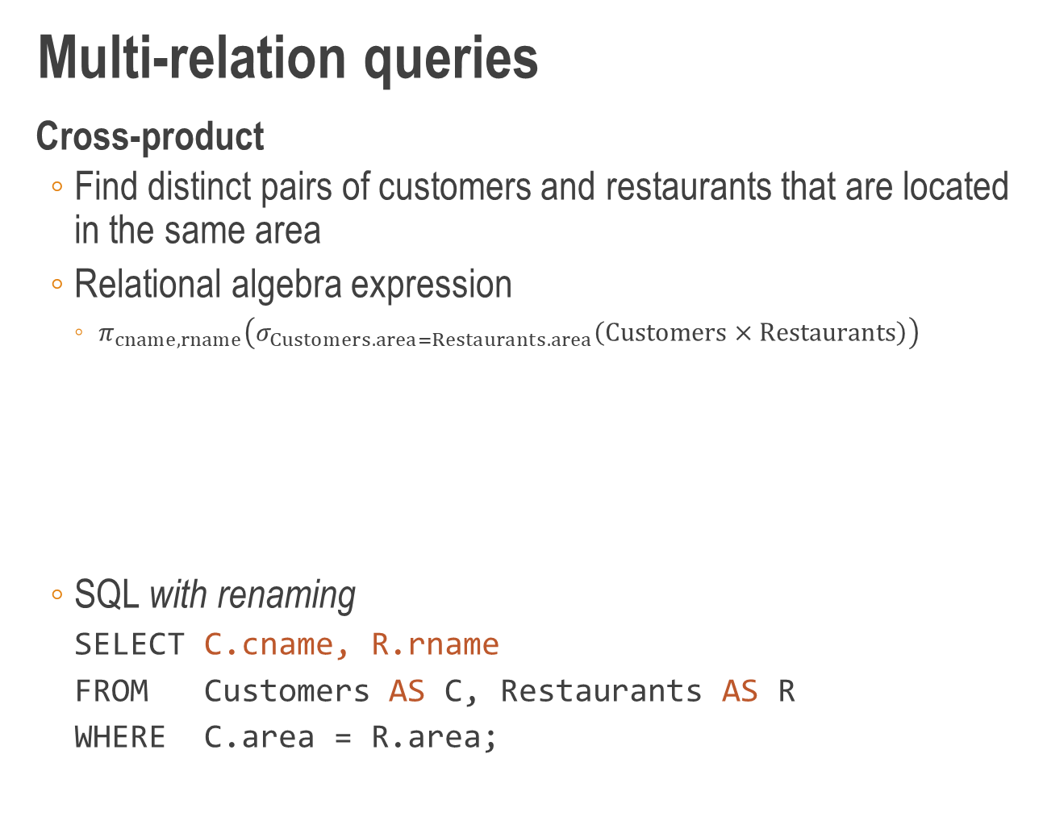
Multi-relation queries
Cross-product
Find distinct pairs of customers and restaurants that are located in the same area
Relational algebra expression
$π_{cname,rname}\left(σ_{Customers.area=Restaurants.area}\left(Customers×Restaurants\right)\right)$
SQL with renaming
SELECT C.cname, R.rname
FROM Customers AS C, Restaurants AS R
WHERE C.area = R.area;
projection
selection
cross product
SELECT
WHERE
FROM

Slide 32
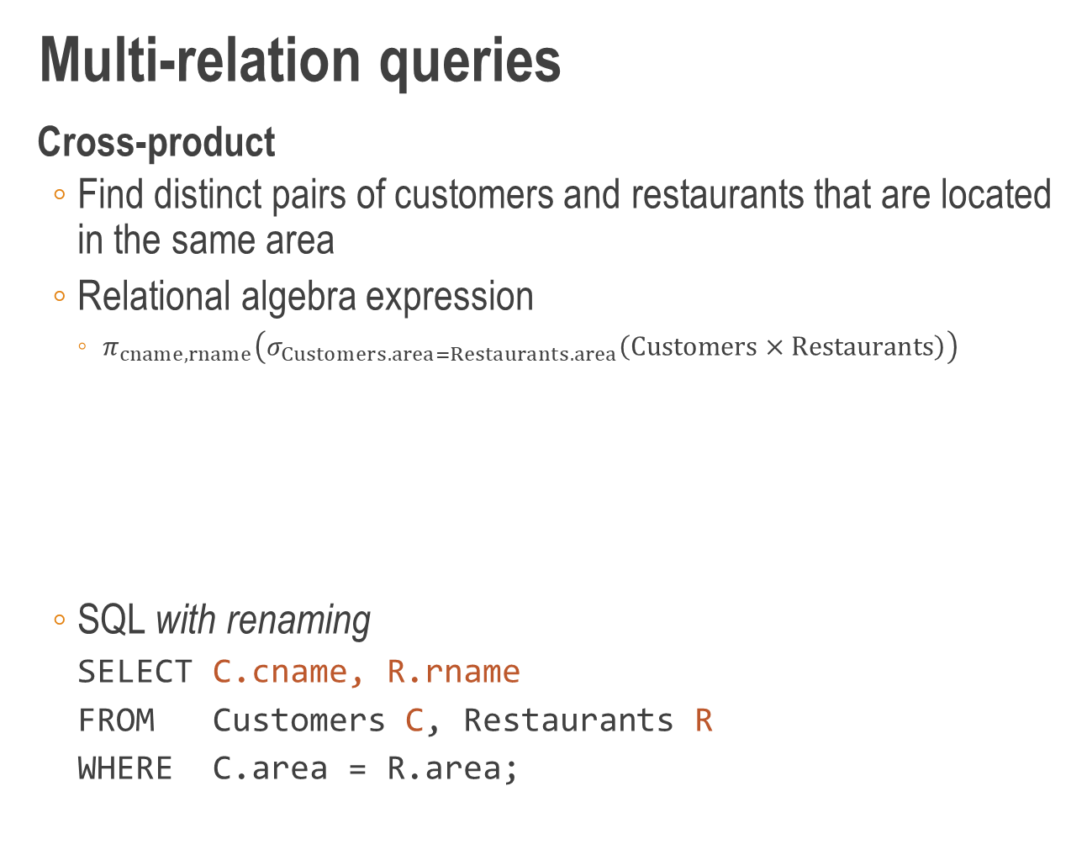
Multi-relation queries
Cross-product
Find distinct pairs of customers and restaurants that are located in the same area
Relational algebra expression
$π_{cname,rname}\left(σ_{Customers.area=Restaurants.area}\left(Customers×Restaurants\right)\right)$
SQL with renaming
SELECT C.cname, R.rname
FROM Customers C, Restaurants R
WHERE C.area = R.area;
projection
selection
cross product
SELECT
WHERE
FROM

Slide 33
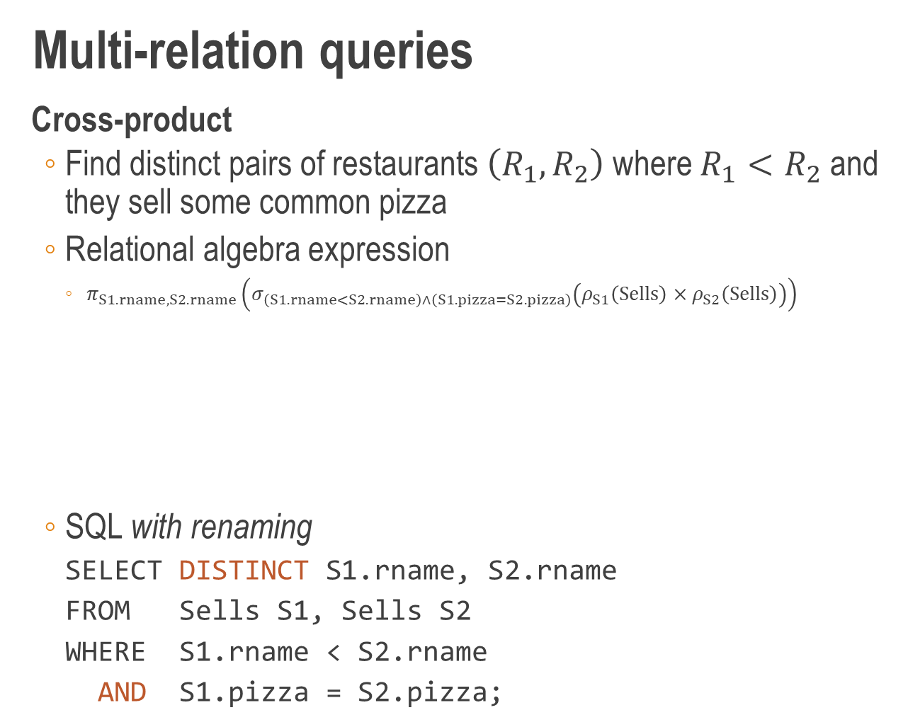
Multi-relation queries
Cross-product
Find distinct pairs of restaurants $\left(R_{1},R_{2}\right)$ where $R_{1}<R_{2}$ and they sell some common pizza
Relational algebra expression
$π_{S1.rname,S2.rname}\left(σ_{\left(S1.rname<S2.rname\right)∧\left(S1.pizza=S2.pizza\right)}\left(ρ_{S1}\left(Sells\right)×ρ_{S2}\left(Sells\right)\right)\right)$
SQL with renaming
SELECT DISTINCT S1.rname, S2.rname
FROM Sells S1, Sells S2
WHERE S1.rname < S2.rname
AND S1.pizza = S2.pizza;
projection
selection
cross product
SELECT
WHERE
AND
FROM

Slide 34
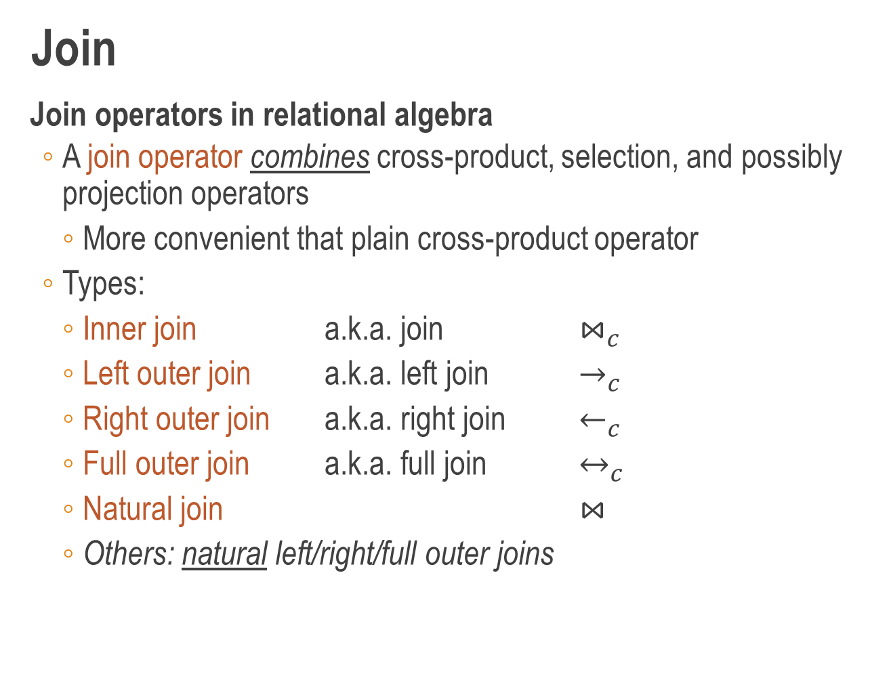
Join
Join operators in relational algebra
A join operator combines cross-product, selection, and possibly projection operators
More convenient that plain cross-product operator
Types:
Inner join a.k.a. join $⋈_{c}$
Left outer join a.k.a. left join $→_{c}$
Right outer join a.k.a. right join $←_{c}$
Full outer join a.k.a. full join $↔_{c}$
Natural join $⋈$
Others: natural left/right/full outer joins

Slide 35
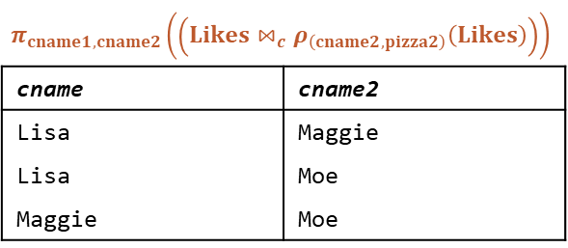
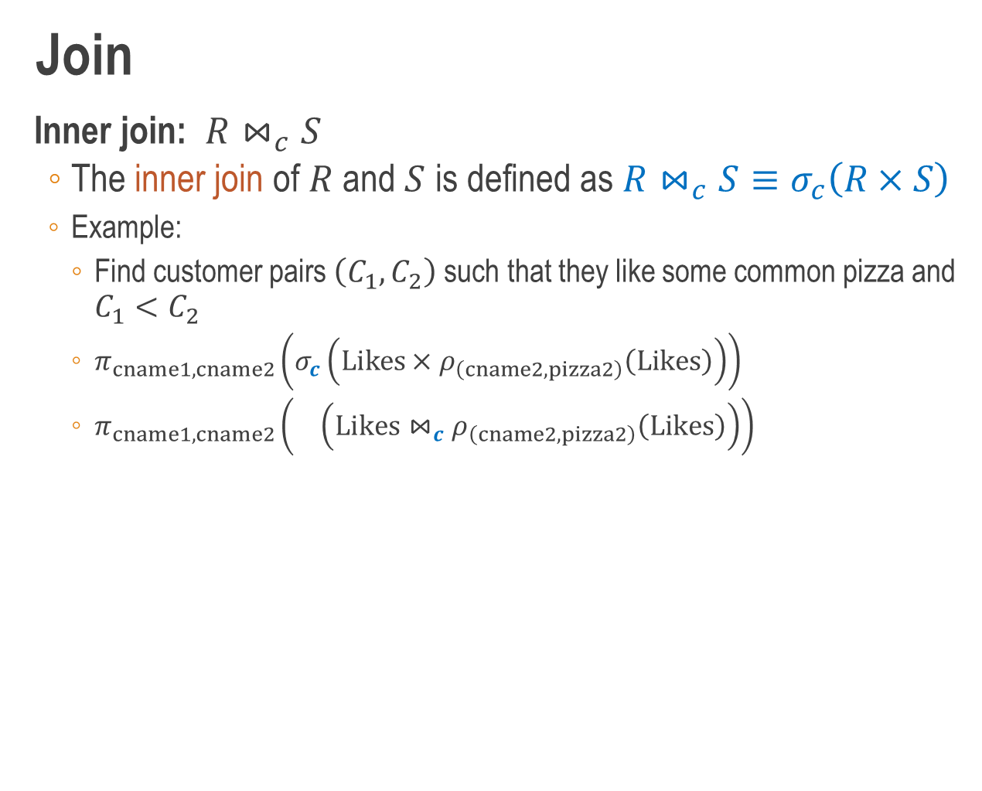

Join
Inner join: $R⋈_{c}S$
The inner join of $R$ and $S$ is defined as $R⋈_{c}S≡σ_{c}\left(R×S\right)$
Example:
Find customer pairs $\left(C_{1},C_{2}\right)$ such that they like some common pizza and $C_{1}<C_{2}$
$π_{cname1,cname2}\left(σ_{c}\left(Likes×ρ_{\left(cname2,pizza2\right)}\left(Likes\right)\right)\right)$
$π_{cname1,cname2}\left( \left(Likes⋈_{c}ρ_{\left(cname2,pizza2\right)}\left(Likes\right)\right)\right)$
Likes
cname | pizza
Homer | Hawaiian
Homer | Margherita
Lisa | Funghi
Maggie | Funghi
Moe | Funghi
Moe | Siciliana
Ralph | Diavola
where $c=\left(pizza=pizza2\right)∧\left(cname<cname2\right)$
$$π_{cname1,cname2}\left(\left(Likes⋈_{c}ρ_{\left(cname2,pizza2\right)}\left(Likes\right)\right)\right)$$
cname | cname2
Lisa | Maggie
Lisa | Moe
Maggie | Moe

Slide 36
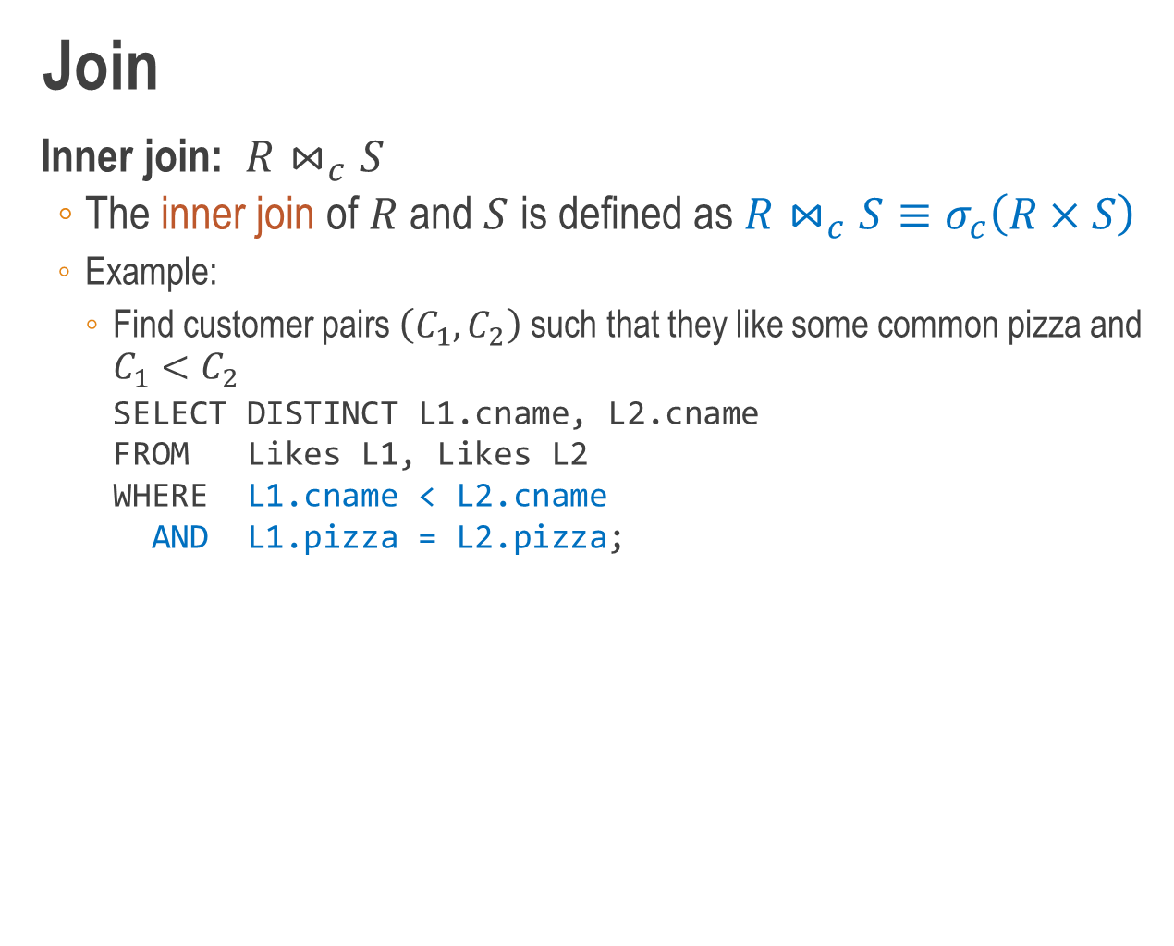
Join
Inner join: $R⋈_{c}S$
The inner join of $R$ and $S$ is defined as $R⋈_{c}S≡σ_{c}\left(R×S\right)$
Example:
Find customer pairs $\left(C_{1},C_{2}\right)$ such that they like some common pizza and $C_{1}<C_{2}$
SELECT DISTINCT L1.cname, L2.cname
FROM Likes L1, Likes L2
WHERE L1.cname < L2.cname
AND L1.pizza = L2.pizza;
Likes
cname | pizza
Homer | Hawaiian
Homer | Margherita
Lisa | Funghi
Maggie | Funghi
Moe | Funghi
Moe | Siciliana
Ralph | Diavola
where $c=\left(pizza=pizza2\right)∧\left(cname<cname2\right)$
$$π_{cname1,cname2}\left(\left(Likes⋈_{c}ρ_{\left(cname2,pizza2\right)}\left(Likes\right)\right)\right)$$
cname | cname2
Lisa | Maggie
Lisa | Moe
Maggie | Moe

Slide 37
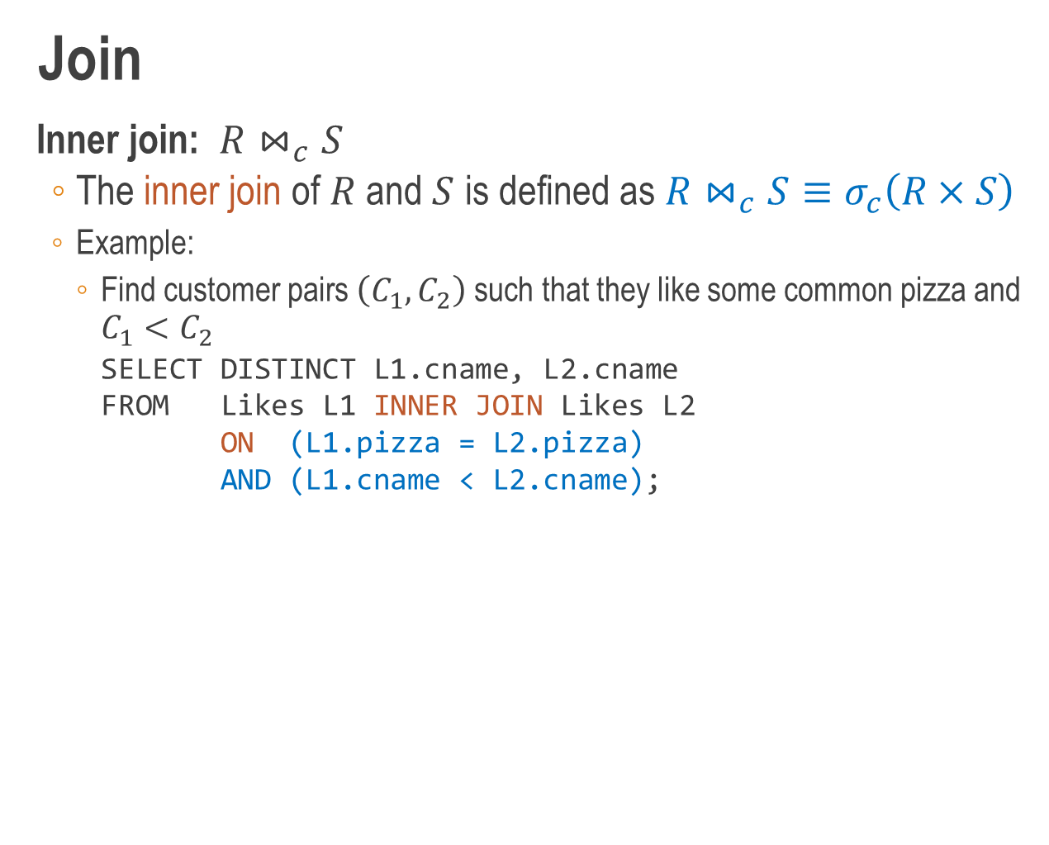
Join
Inner join: $R⋈_{c}S$
The inner join of $R$ and $S$ is defined as $R⋈_{c}S≡σ_{c}\left(R×S\right)$
Example:
Find customer pairs $\left(C_{1},C_{2}\right)$ such that they like some common pizza and $C_{1}<C_{2}$
SELECT DISTINCT L1.cname, L2.cname
FROM Likes L1 INNER JOIN Likes L2
ON (L1.pizza = L2.pizza)
AND (L1.cname < L2.cname);
Likes
cname | pizza
Homer | Hawaiian
Homer | Margherita
Lisa | Funghi
Maggie | Funghi
Moe | Funghi
Moe | Siciliana
Ralph | Diavola
where $c=\left(pizza=pizza2\right)∧\left(cname<cname2\right)$
$$π_{cname1,cname2}\left(\left(Likes⋈_{c}ρ_{\left(cname2,pizza2\right)}\left(Likes\right)\right)\right)$$
cname | cname2
Lisa | Maggie
Lisa | Moe
Maggie | Moe

Slide 38
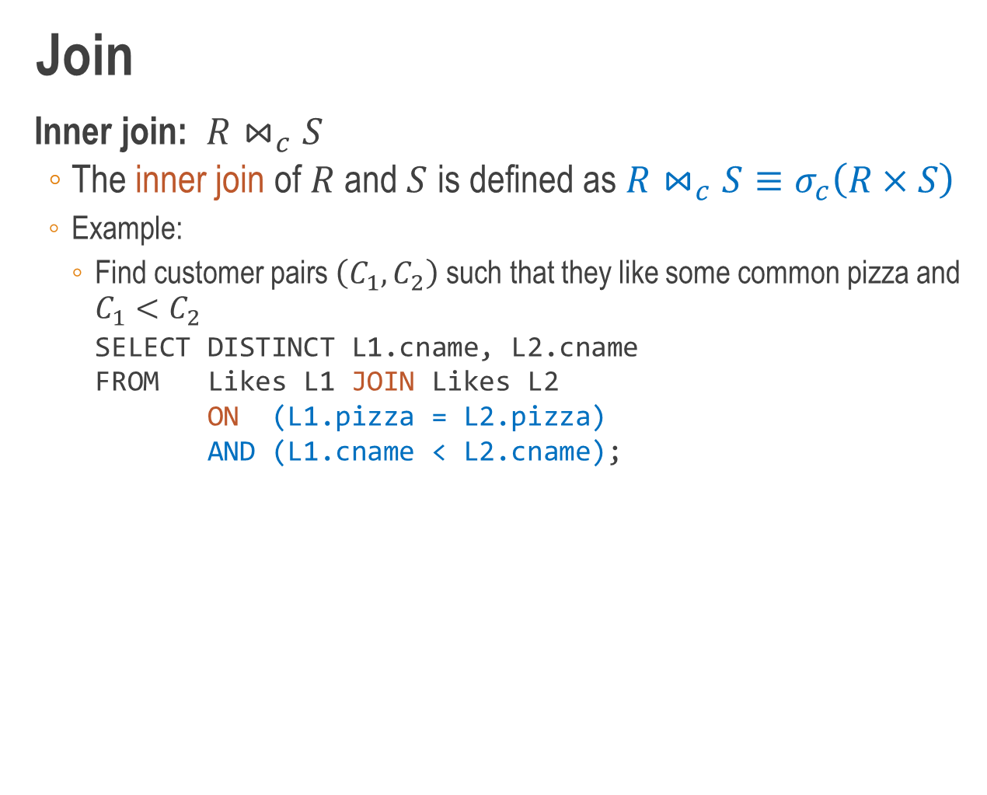
Join
Inner join: $R⋈_{c}S$
The inner join of $R$ and $S$ is defined as $R⋈_{c}S≡σ_{c}\left(R×S\right)$
Example:
Find customer pairs $\left(C_{1},C_{2}\right)$ such that they like some common pizza and $C_{1}<C_{2}$
SELECT DISTINCT L1.cname, L2.cname
FROM Likes L1 JOIN Likes L2
ON (L1.pizza = L2.pizza)
AND (L1.cname < L2.cname);
Likes
cname | pizza
Homer | Hawaiian
Homer | Margherita
Lisa | Funghi
Maggie | Funghi
Moe | Funghi
Moe | Siciliana
Ralph | Diavola
where $c=\left(pizza=pizza2\right)∧\left(cname<cname2\right)$
$$π_{cname1,cname2}\left(\left(Likes⋈_{c}ρ_{\left(cname2,pizza2\right)}\left(Likes\right)\right)\right)$$
cname | cname2
Lisa | Maggie
Lisa | Moe
Maggie | Moe

Slide 39
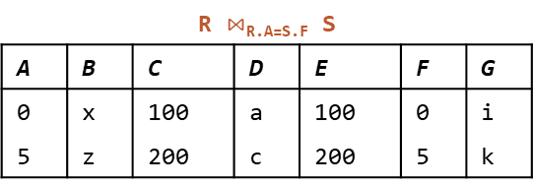
Join
Dangling tuple
A dangling tuple is a tuple in a join operand that does not participate in the join operation
Inner join ignores dangling tuples
To preserve dangling tuple, use outerjoins
R
A | B | C
0 | x | 100
2 | y | 100
4 | w | 400
5 | z | 200
S
D | E | F | G
a | 100 | 0 | i
b | 300 | 1 | j
c | 200 | 5 | k
R $⋈$_{R.A=S.F} S
A | B | C | D | E | F | G
0 | x | 100 | a | 100 | 0 | i
5 | z | 200 | c | 200 | 5 | k

Slide 40
Join
Dangling tuple
A dangling tuple is a tuple in a join operand that does not participate in the join operation
Inner join ignores dangling tuples
To preserve dangling tuple, use outerjoins
R
A | B | C
0 | x | 100
2 | y | 100
4 | w | 400
5 | z | 200
S
D | E | F | G
a | 100 | 0 | i
b | 300 | 1 | j
c | 200 | 5 | k
R $⋈$_{R.A=S.F} S
A | B | C | D | E | F | G
0 | x | 100 | a | 100 | 0 | i
5 | z | 200 | c | 200 | 5 | k

Slide 41

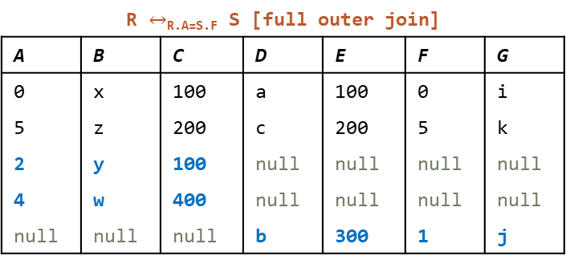
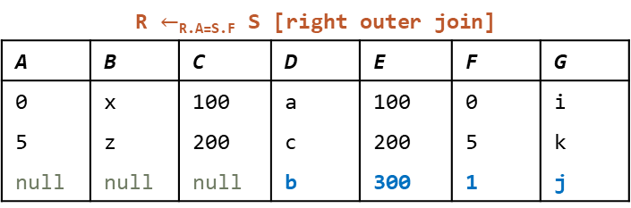
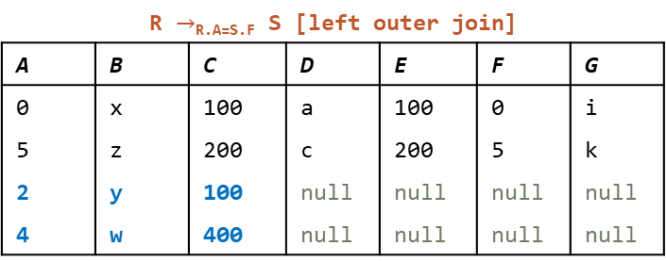
Join
Outerjoin
R $⋈$_{R.A=S.F} S
A | B | C | D | E | F | G
0 | x | 100 | a | 100 | 0 | i
5 | z | 200 | c | 200 | 5 | k
R $→$_{R.A=S.F} S [left outer join]
A | B | C | D | E | F | G
0 | x | 100 | a | 100 | 0 | i
5 | z | 200 | c | 200 | 5 | k
2 | y | 100 | null | null | null | null
4 | w | 400 | null | null | null | null
R
A | B | C
0 | x | 100
2 | y | 100
4 | w | 400
5 | z | 200
S
D | E | F | G
a | 100 | 0 | i
b | 300 | 1 | j
c | 200 | 5 | k
R $←$_{R.A=S.F} S [right outer join]
A | B | C | D | E | F | G
0 | x | 100 | a | 100 | 0 | i
5 | z | 200 | c | 200 | 5 | k
null | null | null | b | 300 | 1 | j
R $↔$_{R.A=S.F} S [full outer join]
A | B | C | D | E | F | G
0 | x | 100 | a | 100 | 0 | i
5 | z | 200 | c | 200 | 5 | k
2 | y | 100 | null | null | null | null
4 | w | 400 | null | null | null | null
null | null | null | b | 300 | 1 | j

Slide 42
Join
Outerjoin definition
Let attr(R) denotes the list of attributes in the schema of R
Example: attr(Sells) = rname, pizza, price
Let null(R) denotes an n-component tuple of null values
n is the arity of relation R
Example: null(Sells) = (null, null, null)

Slide 43
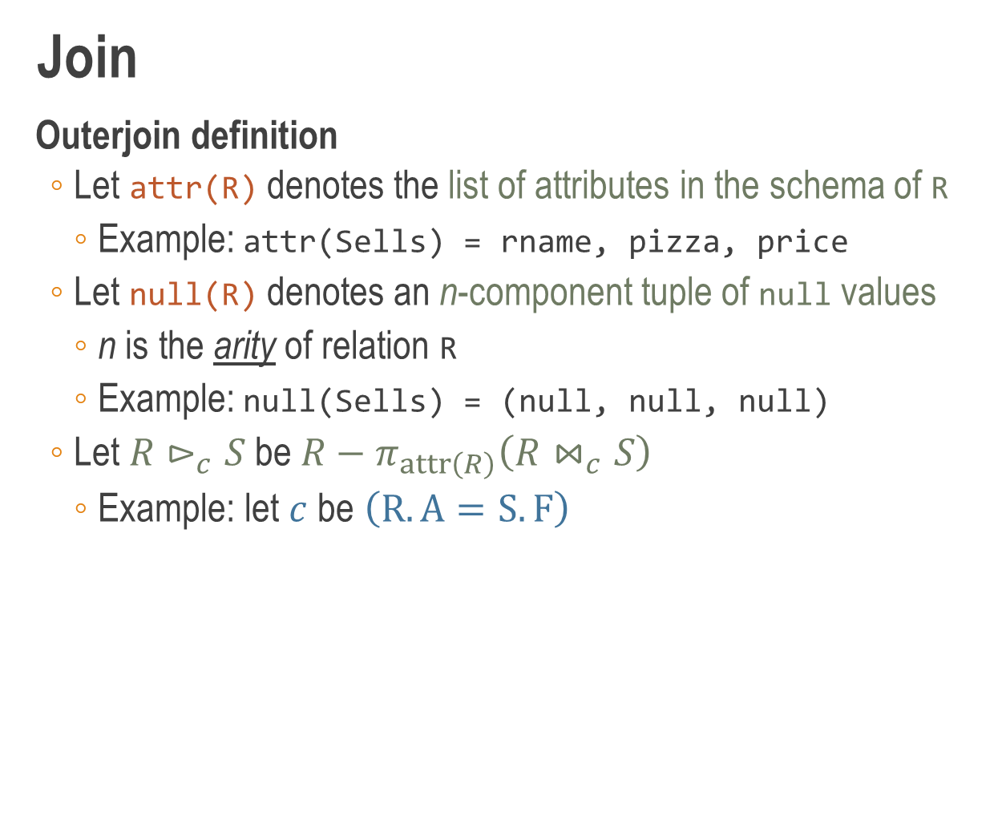
Join
Outerjoin definition
Let attr(R) denotes the list of attributes in the schema of R
Example: attr(Sells) = rname, pizza, price
Let null(R) denotes an n-component tuple of null values
n is the arity of relation R
Example: null(Sells) = (null, null, null)
Let $R⊳_{c}S$ be $R−π_{attr\left(R\right)}\left(R⋈_{c}S\right)$
Example: let $c$ be $\left(R.A=S.F\right)$
R
A | B | C
0 | x | 100
2 | y | 100
4 | w | 400
5 | z | 200
S
D | E | F | G
a | 100 | 0 | i
b | 300 | 1 | j
c | 200 | 5 | k

Slide 44
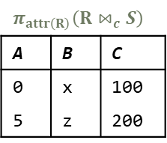
Join
Outerjoin definition
Let attr(R) denotes the list of attributes in the schema of R
Example: attr(Sells) = rname, pizza, price
Let null(R) denotes an n-component tuple of null values
n is the arity of relation R
Example: null(Sells) = (null, null, null)
Let $R⊳_{c}S$ be $R−π_{attr\left(R\right)}\left(R⋈_{c}S\right)$
Example: let $c$ be $\left(R.A=S.F\right)$
R
A | B | C
0 | x | 100
2 | y | 100
4 | w | 400
5 | z | 200
S
D | E | F | G
a | 100 | 0 | i
b | 300 | 1 | j
c | 200 | 5 | k
$$π_{attr\left(R\right)}\left(R⋈_{c}S\right)$$
A | B | C
0 | x | 100
5 | z | 200

Slide 45
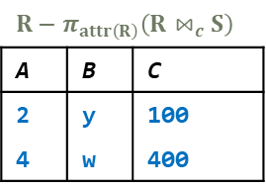
Join
Outerjoin definition
Let attr(R) denotes the list of attributes in the schema of R
Example: attr(Sells) = rname, pizza, price
Let null(R) denotes an n-component tuple of null values
n is the arity of relation R
Example: null(Sells) = (null, null, null)
Let $R⊳_{c}S$ be $R−π_{attr\left(R\right)}\left(R⋈_{c}S\right)$
Example: let $c$ be $\left(R.A=S.F\right)$
R
A | B | C
0 | x | 100
2 | y | 100
4 | w | 400
5 | z | 200
S
D | E | F | G
a | 100 | 0 | i
b | 300 | 1 | j
c | 200 | 5 | k
$$π_{attr\left(R\right)}\left(R⋈_{c}S\right)$$
A | B | C
0 | x | 100
5 | z | 200
$$R−π_{attr\left(R\right)}\left(R⋈_{c}S\right)$$
A | B | C
2 | y | 100
4 | w | 400

Slide 46
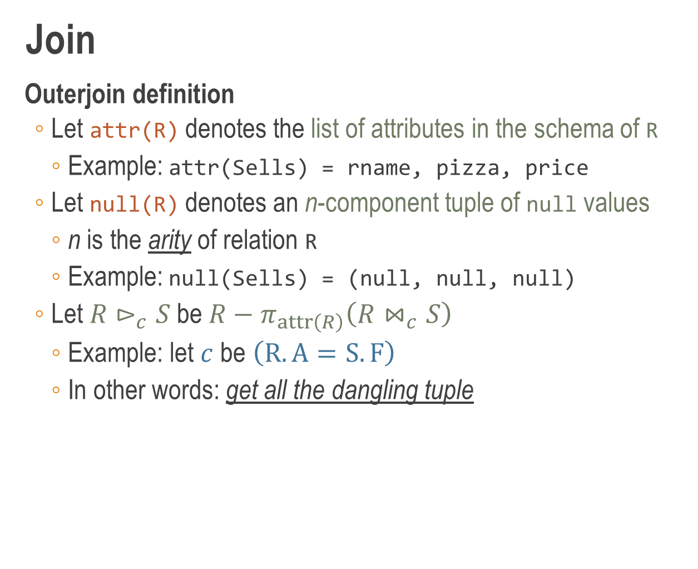
Join
Outerjoin definition
Let attr(R) denotes the list of attributes in the schema of R
Example: attr(Sells) = rname, pizza, price
Let null(R) denotes an n-component tuple of null values
n is the arity of relation R
Example: null(Sells) = (null, null, null)
Let $R⊳_{c}S$ be $R−π_{attr\left(R\right)}\left(R⋈_{c}S\right)$
Example: let $c$ be $\left(R.A=S.F\right)$
In other words: get all the dangling tuple
R
A | B | C
0 | x | 100
2 | y | 100
4 | w | 400
5 | z | 200
S
D | E | F | G
a | 100 | 0 | i
b | 300 | 1 | j
c | 200 | 5 | k
$$π_{attr\left(R\right)}\left(R⋈_{c}S\right)$$
A | B | C
0 | x | 100
5 | z | 200
$$R−π_{attr\left(R\right)}\left(R⋈_{c}S\right)$$
A | B | C
2 | y | 100
4 | w | 400

Slide 47

Join
Outerjoin definition
Left outer join of $R$ and $S$ is defined as
$R→_{c}S≡\left(R⋈_{c}S\right)∪\left(\left(R⊳_{c}S\right)×\left\{null\left(S\right)\right\}\right)$

Slide 48
Join
Outerjoin definition
Left outer join of $R$ and $S$ is defined as
$R→_{c}S≡\left(R⋈_{c}S\right)∪\left(\left(R⊳_{c}S\right)×\left\{null\left(S\right)\right\}\right)$
dangling tuple
null values

Slide 49
Join
Outerjoin definition
Left outer join of $R$ and $S$ is defined as
$R→_{c}S≡\left(R⋈_{c}S\right)∪\left(\left(R⊳_{c}S\right)×\left\{null\left(S\right)\right\}\right)$
dangling tuple
null values
inner join

Slide 50
Join
Outerjoin definition
Left outer join of $R$ and $S$ is defined as
$R→_{c}S≡\left(R⋈_{c}S\right)∪\left(\left(R⊳_{c}S\right)×\left\{null\left(S\right)\right\}\right)$
dangling tuple
null values
inner join
make it union compatible

Slide 51
Join
Outerjoin definition
Left outer join of $R$ and $S$ is defined as
$R→_{c}S≡\left(R⋈_{c}S\right)∪\left(\left(R⊳_{c}S\right)×\left\{null\left(S\right)\right\}\right)$
dangling tuple
null values
inner join
make it union compatible
inner join with dangling tuple added in

Slide 52
Join
Outerjoin definition
Left outer join of $R$ and $S$ is defined as
$R→_{c}S≡\left(R⋈_{c}S\right)∪\left(\left(R⊳_{c}S\right)×\left\{null\left(S\right)\right\}\right)$

Slide 53
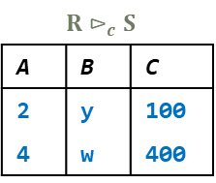
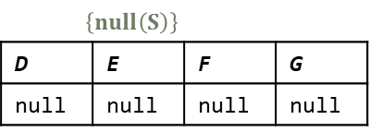
Join
Outerjoin definition
Left outer join of $R$ and $S$ is defined as
$R→_{c}S≡\left(R⋈_{c}S\right)∪\left(\left(R⊳_{c}S\right)×\left\{null\left(S\right)\right\}\right)$
$$R⊳_{c}S$$
A | B | C
2 | y | 100
4 | w | 400
$$\left\{null\left(S\right)\right\}$$
D | E | F | G
null | null | null | null

Slide 54
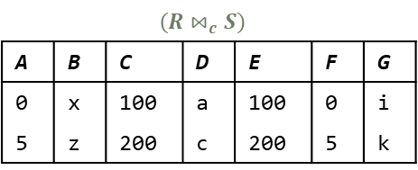
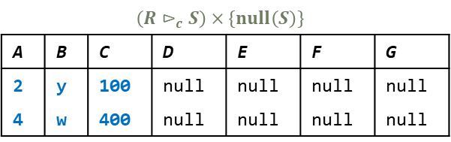
Join
Outerjoin definition
Left outer join of $R$ and $S$ is defined as
$R→_{c}S≡\left(R⋈_{c}S\right)∪\left(\left(R⊳_{c}S\right)×\left\{null\left(S\right)\right\}\right)$
$$R⊳_{c}S$$
A | B | C
2 | y | 100
4 | w | 400
$$\left\{null\left(S\right)\right\}$$
D | E | F | G
null | null | null | null
$$\left(R⋈_{c}S\right)$$
A | B | C | D | E | F | G
0 | x | 100 | a | 100 | 0 | i
5 | z | 200 | c | 200 | 5 | k
$$\left(R⊳_{c}S\right)×\left\{null\left(S\right)\right\}$$
A | B | C | D | E | F | G
2 | y | 100 | null | null | null | null
4 | w | 400 | null | null | null | null

Slide 55

Join
Outerjoin definition
Right outer join of $R$ and $S$ is defined as
$R←_{c}S≡\left(R⋈_{c}S\right)∪\left(\left\{null\left(R\right)\right\}×\left(S⊳_{c}R\right)\right)$
null values
dangling tuple
inner join
make it union compatible
inner join with dangling tuple added in

Slide 56
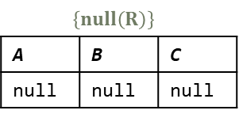

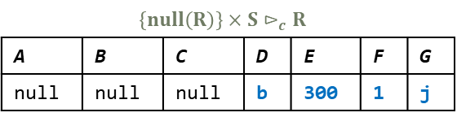
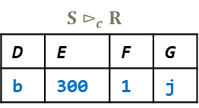
Join
Outerjoin definition
Right outer join of $R$ and $S$ is defined as
$R→_{c}S≡\left(R⋈_{c}S\right)∪\left(\left\{null\left(R\right)\right\}×\left(S⊳_{c}R\right)\right)$
$$\left\{null\left(R\right)\right\}$$
A | B | C
null | null | null
$$S⊳_{c}R$$
D | E | F | G
b | 300 | 1 | j
$$\left(R⋈_{c}S\right)$$
A | B | C | D | E | F | G
0 | x | 100 | a | 100 | 0 | i
5 | z | 200 | c | 200 | 5 | k
$$\left\{null\left(R\right)\right\}×S⊳_{c}R$$
A | B | C | D | E | F | G
null | null | null | b | 300 | 1 | j

Slide 57
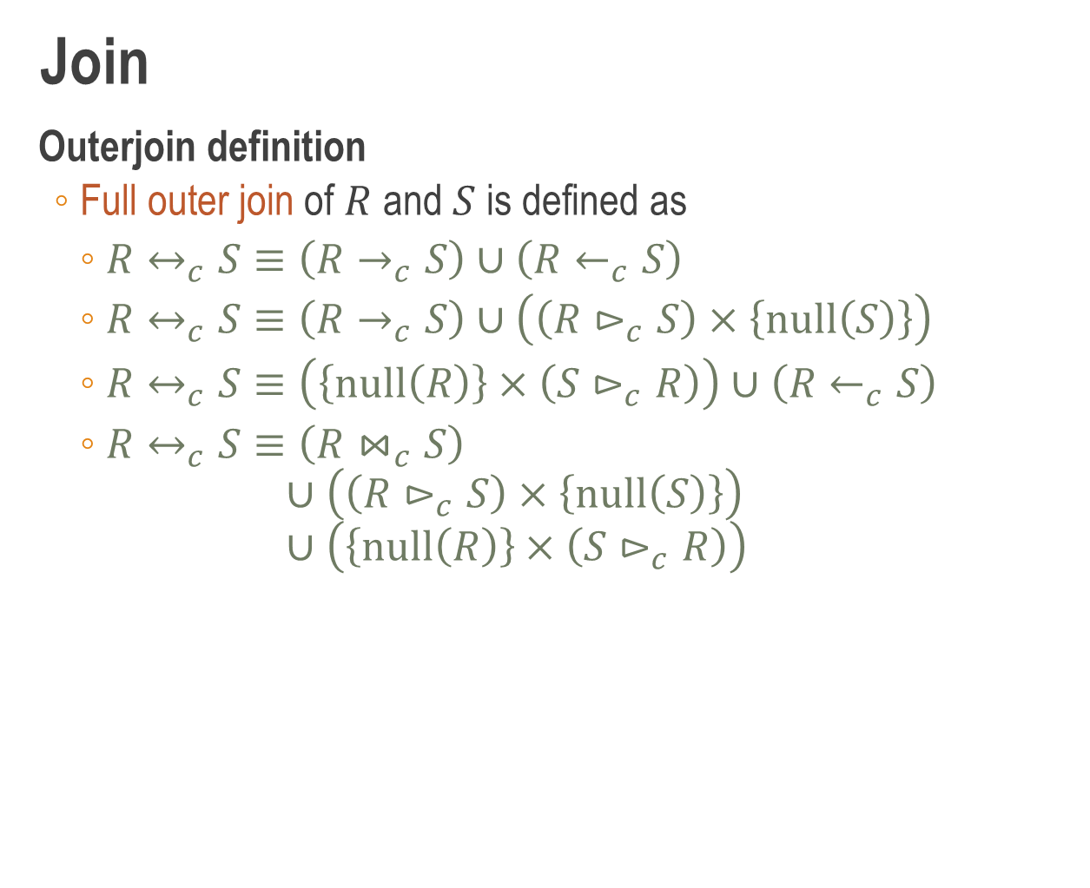
Join
Outerjoin definition
Full outer join of $R$ and $S$ is defined as
$R↔_{c}S≡\left(R→_{c}S\right)∪\left(R←_{c}S\right)$
$R↔_{c}S≡\left(R→_{c}S\right)∪\left(\left(R⊳_{c}S\right)×\left\{null\left(S\right)\right\}\right)$
$R↔_{c}S≡\left(\left\{null\left(R\right)\right\}×\left(S⊳_{c}R\right)\right)∪\left(R←_{c}S\right)$
$R↔_{c}S≡\left(R⋈_{c}S\right)$ $∪\left(\left(R⊳_{c}S\right)×\left\{null\left(S\right)\right\}\right)$ $∪\left(\left\{null\left(R\right)\right\}×\left(S⊳_{c}R\right)\right)$

Slide 58

Join
Example problems
Find customers and the pizzas they like; include also customers who don’t like any pizza
Attempt #1
$Likes$
Does not include customer who don’t like pizza
SELECT * FROM Likes;
Output
cname | pizza
Homer | Hawaiian
Homer | Margherita
Lisa | Funghi
Maggie | Funghi
Moe | Funghi
Moe | Siciliana
Ralph | Diavola

Slide 59
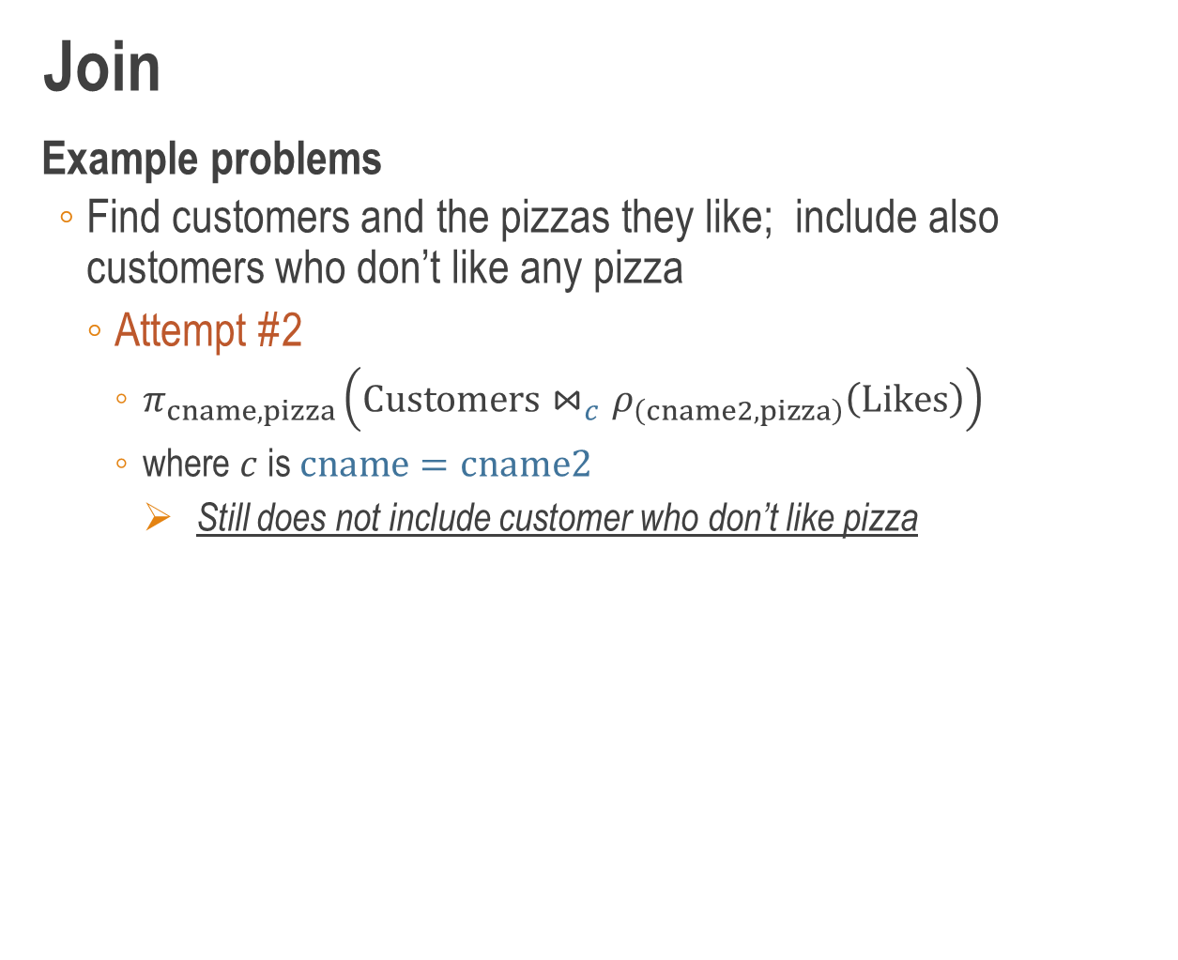
Join
Example problems
Find customers and the pizzas they like; include also customers who don’t like any pizza
Attempt #2
$π_{cname,pizza}\left(Customers⋈_{c}ρ_{\left(cname2,pizza\right)}\left(Likes\right)\right)$
where $c$ is $cname=cname2$
Still does not include customer who don’t like pizza
SELECT C.cname, L.pizza
FROM Customers C
JOIN
Likes L
ON C.cname = L.cname;
Output
cname | pizza
Homer | Hawaiian
Homer | Margherita
Lisa | Funghi
Maggie | Funghi
Moe | Funghi
Moe | Siciliana
Ralph | Diavola

Slide 60

Join
Example problems
Find customers and the pizzas they like; include also customers who don’t like any pizza
Attempt #3
$π_{cname,pizza}\left(Customers→_{c}ρ_{\left(cname2,pizza\right)}\left(Likes\right)\right)$
where $c$ is $cname=cname2$
Output
cname | pizza
Homer | Hawaiian
Homer | Margherita
Lisa | Funghi
Maggie | Funghi
Moe | Funghi
Moe | Siciliana
Ralph | Diavola
Willie | null
SELECT C.cname, L.pizza
FROM Customers C
LEFT JOIN
Likes L
ON C.cname = L.cname;

Slide 61
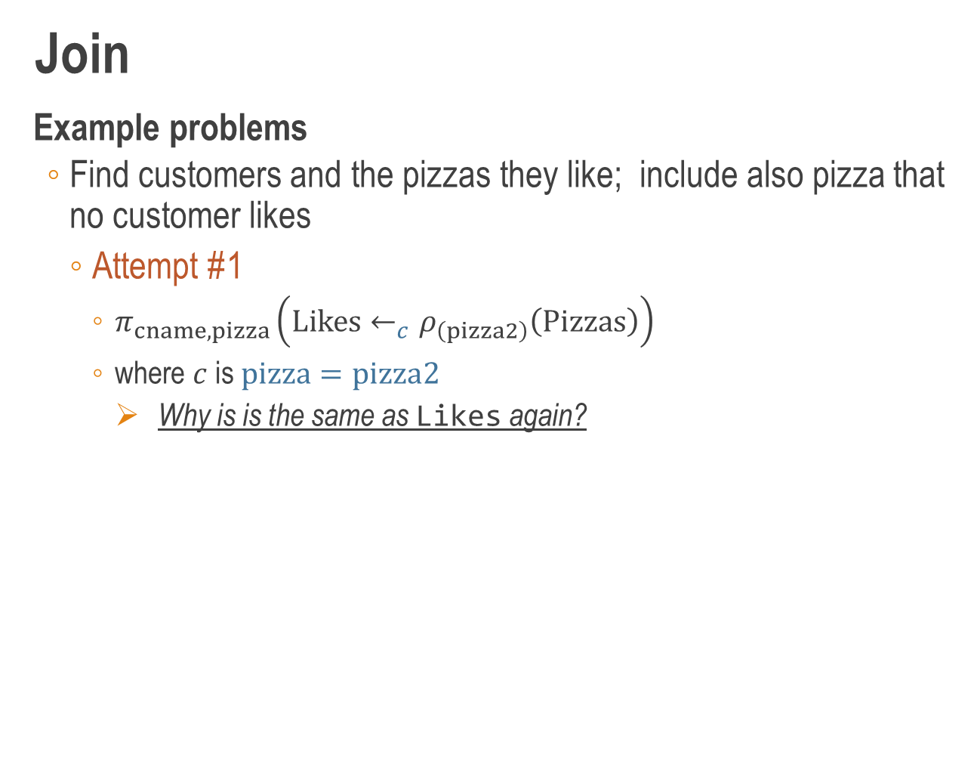
Join
Example problems
Find customers and the pizzas they like; include also pizza that no customer likes
Attempt #1
$π_{cname,pizza}\left(Likes←_{c}ρ_{\left(pizza2\right)}\left(Pizzas\right)\right)$
where $c$ is $pizza=pizza2$
Why is is the same as Likes again?
SELECT L.cname, L.pizza
FROM Likes L
RIGHT JOIN
Pizzas P
ON L.pizza = P.pizza;
Output
cname | pizza
Homer | Hawaiian
Homer | Margherita
Lisa | Funghi
Maggie | Funghi
Moe | Funghi
Moe | Siciliana
Ralph | Diavola

Slide 62
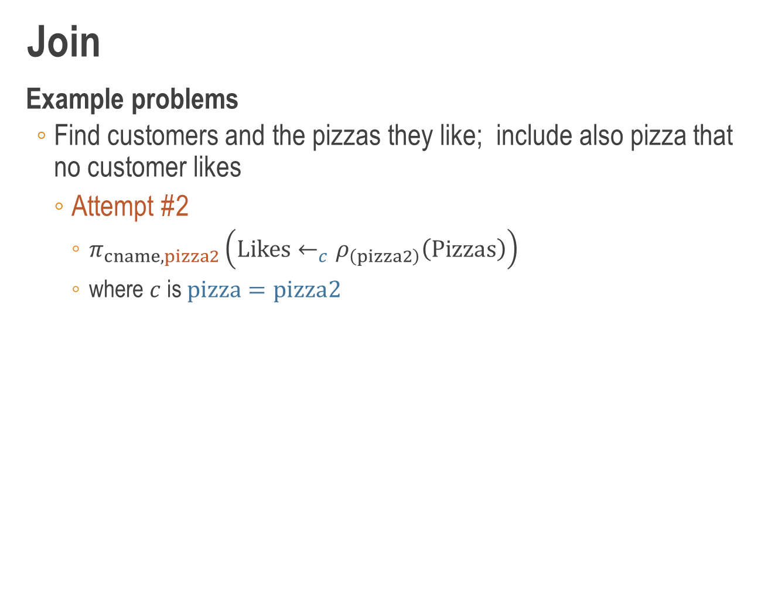
Join
Example problems
Find customers and the pizzas they like; include also pizza that no customer likes
Attempt #2
$π_{cname,pizza2}\left(Likes←_{c}ρ_{\left(pizza2\right)}\left(Pizzas\right)\right)$
where $c$ is $pizza=pizza2$
Output
cname | pizza2
Homer | Hawaiian
Homer | Margherita
Lisa | Funghi
Maggie | Funghi
Moe | Funghi
Moe | Siciliana
Ralph | Diavola
null | Marinara
SELECT L.cname, P.pizza
FROM Likes L
RIGHT JOIN
Pizzas P
ON L.pizza = P.pizza;

Slide 63
Join
Example problems
Find customers and the pizzas they like; include also customers who don’t like any pizza and pizza that no customer likes
Attempt #1
SELECT C.cname, P.pizza
FROM Customers C
FULL JOIN
Likes L
ON C.cname = L.cname
FULL JOIN
Pizzas P
ON L.pizza = P.pizza;
Output
cname | pizza2
Homer | Hawaiian
Homer | Margherita
Lisa | Funghi
Maggie | Funghi
Moe | Funghi
Moe | Siciliana
Ralph | Diavola
Willie | null
null | Marinara

Slide 64
Join
Example problems
Find customers and the pizzas they like; include also customers who don’t like any pizza and pizza that no customer likes
Attempt #2
SELECT C.cname, L.pizza
FROM Customers C LEFT JOIN Likes L
ON C.cname = L.cname
UNION
SELECT L.cname, P.pizza
FROM Likes L RIGHT JOIN Pizzas P
ON L.pizza = P.pizza;
Output
cname | pizza2
Homer | Hawaiian
Homer | Margherita
Lisa | Funghi
Maggie | Funghi
Moe | Funghi
Moe | Siciliana
Ralph | Diavola
Willie | null
null | Marinara

Slide 65
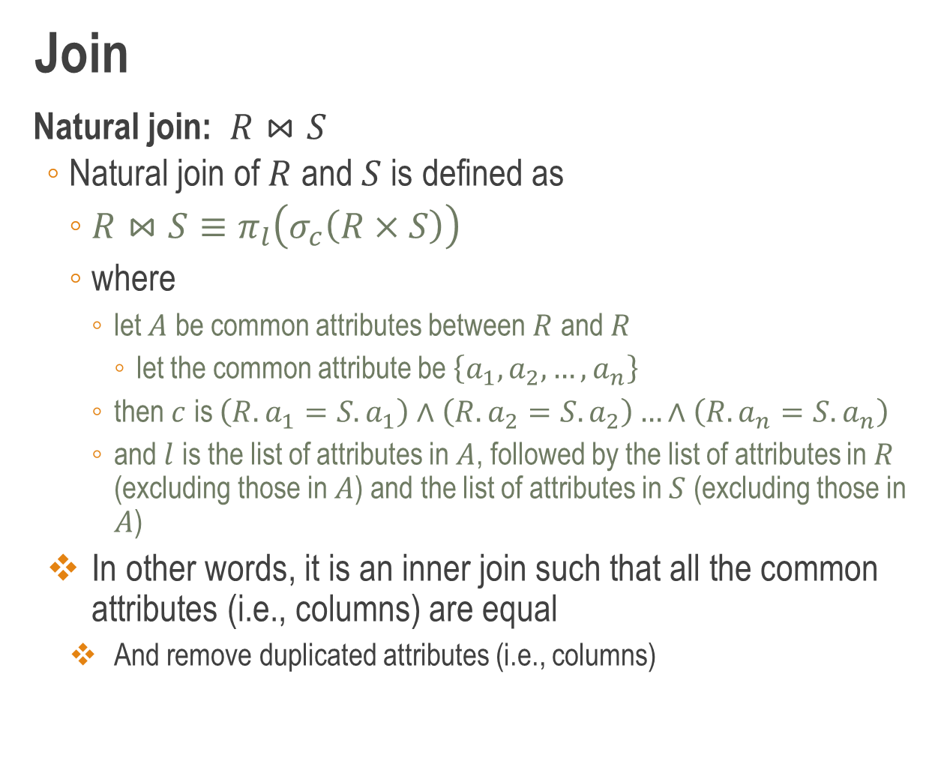
Join
Natural join: $R⋈S$
Natural join of $R$ and $S$ is defined as
$R⋈S≡π_{l}\left(σ_{c}\left(R×S\right)\right)$
where
let $A$ be common attributes between $R$ and $R$
let the common attribute be $\left\{a_{1},a_{2},…,a_{n}\right\}$
then $c$ is $\left(R.a_{1}=S.a_{1}\right)∧\left(R.a_{2}=S.a_{2}\right)…∧\left(R.a_{n}=S.a_{n}\right)$
and $l$ is the list of attributes in $A$, followed by the list of attributes in $R$ (excluding those in $A$) and the list of attributes in $S$ (excluding those in $A$)
In other words, it is an inner join such that all the common attributes (i.e., columns) are equal
And remove duplicated attributes (i.e., columns)

Slide 66
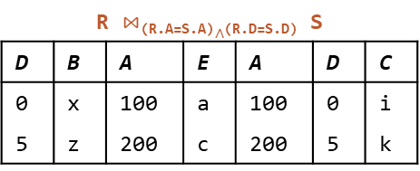
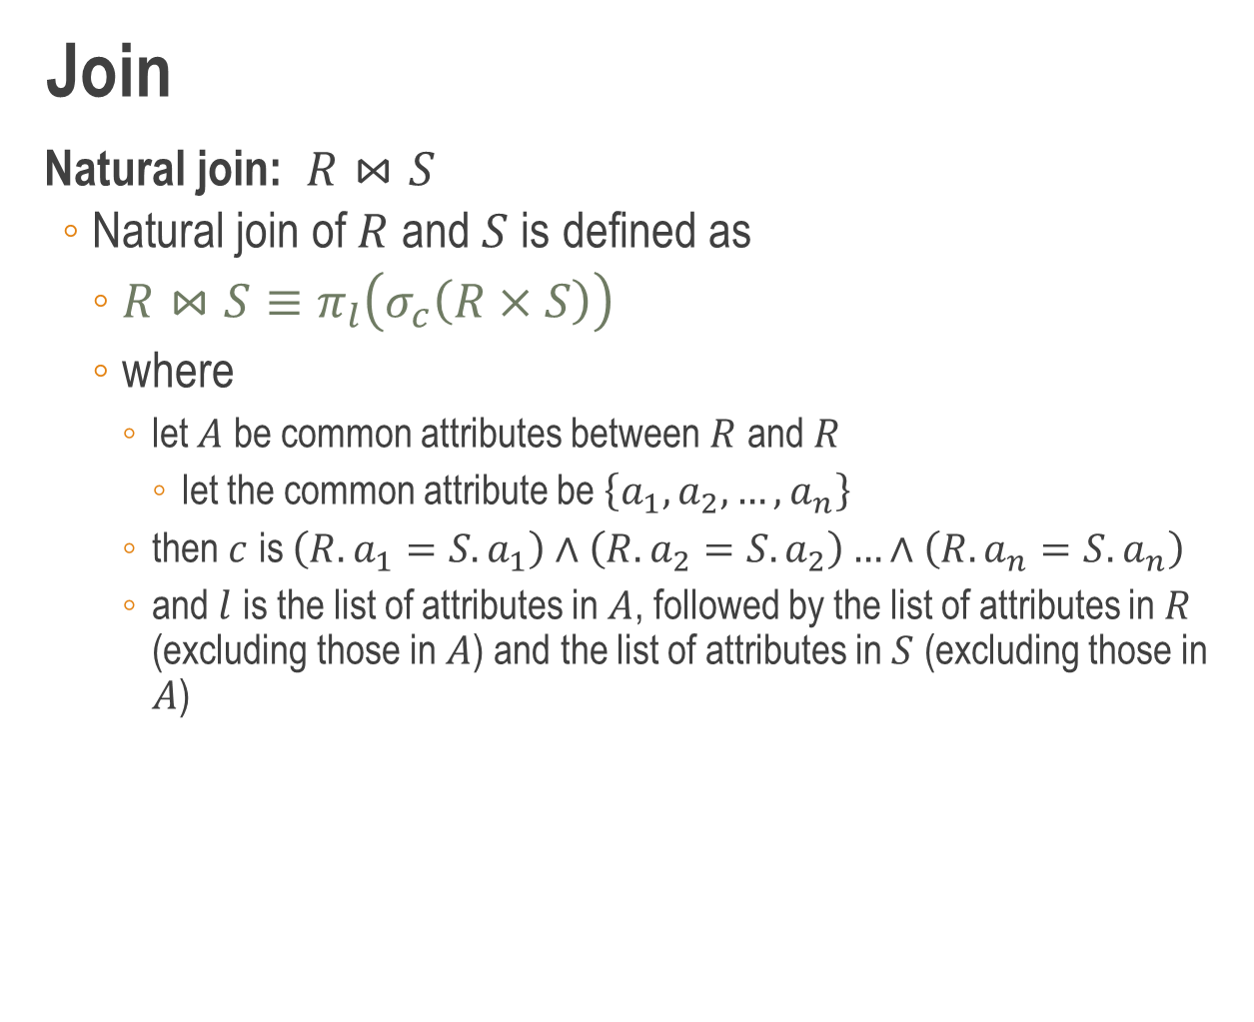
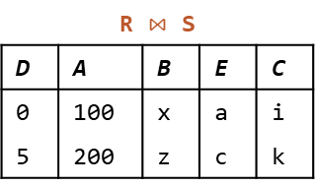
Join
Natural join: $R⋈S$
Natural join of $R$ and $S$ is defined as
$R⋈S≡π_{l}\left(σ_{c}\left(R×S\right)\right)$
where
let $A$ be common attributes between $R$ and $R$
let the common attribute be $\left\{a_{1},a_{2},…,a_{n}\right\}$
then $c$ is $\left(R.a_{1}=S.a_{1}\right)∧\left(R.a_{2}=S.a_{2}\right)…∧\left(R.a_{n}=S.a_{n}\right)$
and $l$ is the list of attributes in $A$, followed by the list of attributes in $R$ (excluding those in $A$) and the list of attributes in $S$ (excluding those in $A$)
R $⋈$_{(R.A=S.A)}$∧$_{(R.D=S.D)} S
D | B | A | E | A | D | C
0 | x | 100 | a | 100 | 0 | i
5 | z | 200 | c | 200 | 5 | k
R
D | B | A
0 | x | 100
2 | y | 100
4 | w | 400
5 | z | 200
S
E | A | D | C
a | 100 | 0 | i
b | 300 | 1 | j
c | 200 | 5 | k
R $⋈$ S
D | A | B | E | C
0 | 100 | x | a | i
5 | 200 | z | c | k

Slide 67
Join
Natural join: example problem
For each restaurant, find its name, area, and the pizzas it sells together with their prices
Restaurants
rname | area
Corleone Corner | North
Gambino Oven | Central
Lorenzo Tavern | Central
Mamma’s Place | South
Pizza King | East
SELECT R.rname, R.area,
S.pizza, S.price
FROM Restaurants R,
Sells S
WHERE R.rname = S.rname;
Sells
rname | pizza | price
Corleone Corner | Diavola | 24
Corleone Corner | Hawaiian | 25
Corleone Corner | Margherita | 19
Gambino Oven | Siciliana | 16
Lorenzo Tavern | Funghi | 23
Mamma’s Place | Marinara | 22
Pizza King | Diavola | 17
Pizza King | Hawaiian | 21
Output
rname | area | pizza | price
Corleone Corner | North | Diavola | 24
Corleone Corner | North | Hawaiian | 25
Corleone Corner | North | Margherita | 19
Gambino Oven | Central | Siciliana | 16
Lorenzo Tavern | Central | Funghi | 23
Mamma’s Place | South | Marinara | 22
Pizza King | East | Diavola | 17
Pizza King | East | Hawaiian | 21

Slide 68
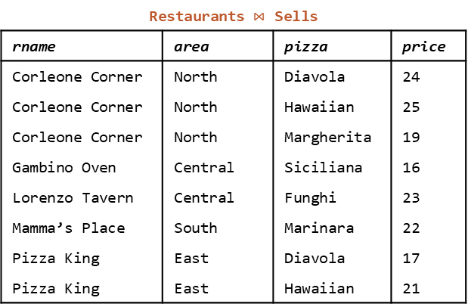
Join
Natural join: example problem
For each restaurant, find its name, area, and the pizzas it sells together with their prices
Restaurants
rname | area
Corleone Corner | North
Gambino Oven | Central
Lorenzo Tavern | Central
Mamma’s Place | South
Pizza King | East
SELECT *
FROM Restaurants
NATURAL JOIN
Sells;
Sells
rname | pizza | price
Corleone Corner | Diavola | 24
Corleone Corner | Hawaiian | 25
Corleone Corner | Margherita | 19
Gambino Oven | Siciliana | 16
Lorenzo Tavern | Funghi | 23
Mamma’s Place | Marinara | 22
Pizza King | Diavola | 17
Pizza King | Hawaiian | 21
Restaurants $⋈$ Sells
rname | area | pizza | price
Corleone Corner | North | Diavola | 24
Corleone Corner | North | Hawaiian | 25
Corleone Corner | North | Margherita | 19
Gambino Oven | Central | Siciliana | 16
Lorenzo Tavern | Central | Funghi | 23
Mamma’s Place | South | Marinara | 22
Pizza King | East | Diavola | 17
Pizza King | East | Hawaiian | 21

Slide 69
Join
Natural join: example problem
Find distinct names of restaurants that sell some pizza for under $20 that Homer likes
SELECT DISTINCT S.rname
FROM Sells S, Likes L
WHERE S.price < 20
AND L.cname = ‘Homer’
AND S.pizza = L.pizza;
Likes
cname | pizza
Homer | Hawaiian
Homer | Margherita
Lisa | Funghi
: | :
Sells
rname | pizza | price
Corleone Corner | Diavola | 24
Corleone Corner | Hawaiian | 25
Corleone Corner | Margherita | 19
Gambino Oven | Siciliana | 16
Lorenzo Tavern | Funghi | 23
Mamma’s Place | Marinara | 22
Pizza King | Diavola | 17
Pizza King | Hawaiian | 21
Output
rname | area | pizza | price
Corleone Corner | North | Diavola | 24
Corleone Corner | North | Hawaiian | 25
Corleone Corner | North | Margherita | 19
Gambino Oven | Central | Siciliana | 16
Lorenzo Tavern | Central | Funghi | 23
Mamma’s Place | South | Marinara | 22
Pizza King | East | Diavola | 17
Pizza King | East | Hawaiian | 21

Slide 70
Join
Natural join: example problem
Find distinct names of restaurants that sell some pizza for under $20 that Homer likes
SELECT DISTINCT S.rname
FROM Sells S
NATURAL JOIN Likes L
WHERE S.price < 20
AND L.cname = ‘Homer’;
Likes
cname | pizza
Homer | Hawaiian
Homer | Margherita
Lisa | Funghi
: | :
Sells
rname | pizza | price
Corleone Corner | Diavola | 24
Corleone Corner | Hawaiian | 25
Corleone Corner | Margherita | 19
Gambino Oven | Siciliana | 16
Lorenzo Tavern | Funghi | 23
Mamma’s Place | Marinara | 22
Pizza King | Diavola | 17
Pizza King | Hawaiian | 21
Output
rname | area | pizza | price
Corleone Corner | North | Diavola | 24
Corleone Corner | North | Hawaiian | 25
Corleone Corner | North | Margherita | 19
Gambino Oven | Central | Siciliana | 16
Lorenzo Tavern | Central | Funghi | 23
Mamma’s Place | South | Marinara | 22
Pizza King | East | Diavola | 17
Pizza King | East | Hawaiian | 21

Slide 71
Overview
More conditions
Pattern matching
Conditional expressions: case analysis
Conditional expressions: null analysis
Multi-relation queries
Set operations
Cross-product
Join: inner join, left outer join, right outer join, full outer join, natural join
Views

Slide 72
Views
Introduction
A view defines a virtual relation that can be used for querying
Example
Consider the following database schema
Courses (cid, cname, credit, pid, time, quota)
Profs (pid, pname, room, contact)
Enrollments (cid, ugrad, pgrad, exchange, audit)
Course information
CREATE VIEW CourseInfo AS
SELECT C.cname, P.pname, C.time, C.quota,
E.ugrad+E.pgrad+E.exchange+E.audit AS enrolled
FROM Courses C, Profs P, Enrollments E
WHERE C.pid = P.pid
AND C.cid = E.cid;

Slide 73
Views
Introduction
A view defines a virtual relation that can be used for querying
Example
Consider the following database schema
Courses (cid, cname, credit, pid, time, quota)
Profs (pid, pname, room, contact)
Enrollments (cid, ugrad, pgrad, exchange, audit)
Course information
CREATE VIEW CourseInfo(cname,pname,time,quota,enrolled) AS
SELECT C.cname, P.pname, C.time, C.quota,
E.ugrad+E.pgrad+E.exchange+E.audit
FROM Courses C, Profs P, Enrollments E
WHERE C.pid = P.pid
AND C.cid = E.cid;

Slide 74
Views
Data independence
Physical schema how the data described by the logical schema is physically organized in DBMS
Logical schema logical structure of data in DBMS
External schema a customized view of logical schema
Logical (physical) data independence
Insulate users/applications from changes to logical (physical) schema
External Schema 1
External Schema 2
...
External Schema n
Logical Schema
Physical Schema

Slide 75
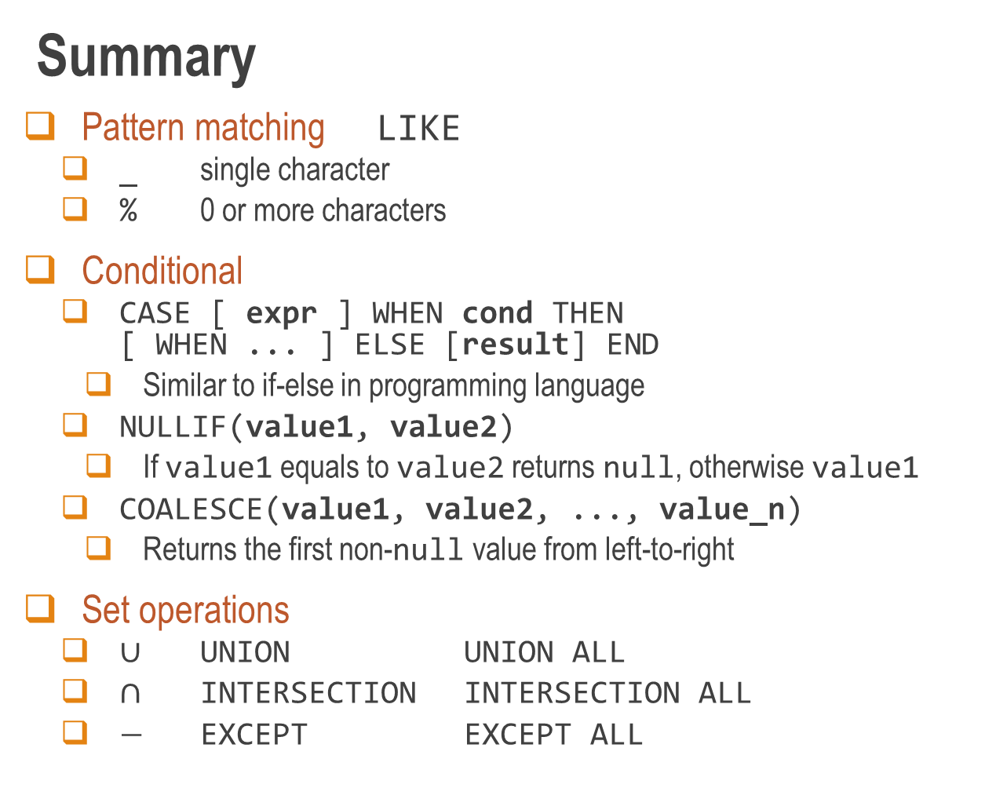
Summary
Pattern matching LIKE
_ single character
% 0 or more characters
Conditional
CASE [ expr ] WHEN cond THEN [ WHEN ... ] ELSE [result] END
Similar to if-else in programming language
NULLIF(value1, value2)
If value1 equals to value2 returns null, otherwise value1
COALESCE(value1, value2, ..., value_n)
Returns the first non-null value from left-to-right
Set operations
$∪$ UNION UNION ALL
$∩$ INTERSECTION INTERSECTION ALL
$−$ EXCEPT EXCEPT ALL

Slide 76

Summary
(source: The Code Project article by C.L. Moffatt)

